Slide 1
Smolt Survival and Travel Time & Transportation Analyses
Update with 2022 Data
Northwest Fisheries Science Center
USACE Anadromous Fish Evaluation Program
Annual Review 2022
January 18, 2023
Steven G. Smith
steven.g.smith@noaa.gov

Slide 2
Smolt Survival
Migration conditions, travel time and survival of PIT-tagged smolts through the hydropower system in 2022
  Preliminary Results Memo: October 20, 2022 – no bird recovery data
  Today – bird recovery data from estuary included (n.b.: still preliminary)
  Mid-river bird recovery data?
    Investigation in 2021 Annual Report, recently completed
    Benefits equivocal: more information, but also more parameters to estimate
  2022 Annual Report to BPA in prep
    Only those fish left to migrate in-river
    Only juvenile data, not survival to adult

Slide 3
2022 Spring Conditions
  Flow very low throughout April,
  above average at end of May/beginning of June
  Cool water throughout season
  Very high spill percentage – mostly matched 2021
  Moderate dissolved gas during low flow,
    higher TDGS in higher flow

Slide 4
2022 Spring Migration
  Travel times
    Long during low-flow, cool April; more typical at end of season
  Late migration => Higher proportion transported
  Very low numbers passed dams via juvenile bypass systems
    Low PIT-tag detection probabilities (data quality diminished)
    Low numbers collected for transportation
      (but few passed before transportation began)

Slide 5
2022 Spring Survival Estimates
Snake River Yearling Chinook and Steelhead:
  Slightly above average
Columbia River Yearling Chinook and Steelhead:
  - Below average to McNary Dam; average in lower Columbia
McNary-to-Bonneville below average for multiple stocks in 2021; not repeated in 2022
Generally imprecise because of low detection rates
- some >100%, and some “seesaw” reach-to-reach,
  likely for same reason

Slide 6
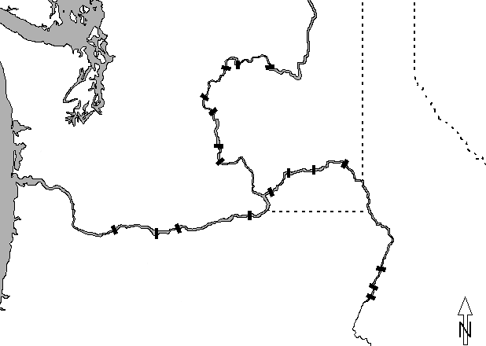


PIT-tag Data Sources
Chief Joseph
H & W
Releases
Wells
Grand Coulee
Rocky Reach
Rock Island
Wanapum
Tagging for
Surv. & Transp.
Ice Harbor
Priest Rapids
Snake R. trap
PIT-trawl
Bird colonies
Pile dikes
Juvenile detectors
Lower Granite
Little Goose
Lower Monumental
H & W
Releases
McNary
Bonneville
John Day
The Dalles
Hells Canyon
Oxbow
Brownlee
Notes:
Map etc.

Slide 7
Detection Probabilities

Slide 8
Detection Probabilities

Slide 14
Passage Timing at Lower Granite Dam

Slide 20

Snake River
Yearling Chinook
reach survival
LGS
LWG
LMO
SRT
IHR
94.3 (90.7)
94.7 (93.1)
BON
TDA
JDA
MCN
2022
89.0
84.5
89.7
103.4
75.5
96.3
BON
JDA
MCN
LMO
LGS
LWG
SRT
Mean 02-22
82.5
87.7
86.8
96.4
91.1
91.9
Notes:
Source: for most recent year: Table 25 of Report (Table 16 for LMO-ICE, ICE-MCN)
For average: sgs’s “Clean S” spreadsheet – averages for 2002-2011

Slide 21
Snake River
Steelhead
reach survival
LGS
LWG
LMO
SRT
IHR
81.5 (88.8)
82.4 (88.0)
BON
TDA
JDA
MCN
2022
66.5
132.6
67.9
99.3
87.8
94.0
BON
JDA
MCN
LMO
LGS
LWG
SRT
Mean 02-22
79.5
88.9
77.7
93.8
95.0
96.4
Notes:
Source: for most recent year: Table 25 of Report (Table 16 for LMO-ICE, ICE-MCN)
For average: sgs’s “Clean S” spreadsheet – averages for 2002-2011

Slide 28
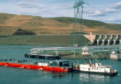

Slide 29
Acknowledgments
Bonneville Power Administration
PTAGIS – Pacific States Marine Fisheries Commission
Avian Predation Detection Project
  Real Time Research
  Corps of Engineers Fish Field Units
DART – University of Washington Columbia Basin Research
NOAA Colleagues: Jim Faulkner, Dan Widener
Legions of Taggers, Coordinators, Agencies, etc.

Slide 30
Smolt Transportation
Yearling Chinook & Steelhead
Data from Migration Years 2017-2020
      Updated with adult returns through Dec 31, 2022
      Added smolt migration year 2020
      Spillway-passed fish at LGR

Slide 31
Snake River Conditions
Migration Year | Flow | Spill% | Temperature | Dissolved gas
2017 | Very high | Very high (40-50%) | Average | Very high (118-126%)
2018 | High | High (35-55%) | Warm | Above average (116-122%)
2019 | High | Above average (35-45%) | Average; Fluctuating | Above average (118-120%)
2020 | Average | Record high (60-65%) | Warm April, Cool May | High (120-124%)

Slide 32
Annual Summaries

Slide 33
Annual Estimated SARs – Transport Period
2017
2018
2019
2020

Slide 34
Annual Estimated T:B – Transport Period
2017
2018
2019
2020

Slide 35
Annual Estimated SARs – Transport Period
2017
2018
2019
2020

Slide 36
Annual Estimated T:B – Transport Period
2017
2018
2019
2020

Slide 37
Spillway Detector – Migration Year 2020
Wild chinook
Wild steelhead
Hatchery chinook
Hatchery steelhead
1.29; P=0.32
2.27; P=0.10
1.25; P=0.34
1.26; P=0.16

Slide 38
Some Seasonal Stuff for 2020

Slide 39
Estimating Patterns of SAR vs. Date
Need a “time-stamp” – date of passage/detection.
  (Time-stamp still needed for annual summaries – “transport period”).
  Starting 2020: time-stamp available for LGR-spillway-passed fish!
These analyses use fish that entered JBS at LGR, LGS, or LMN
  tagged upstream of LGR or at LGR
  either transported (T) or bypassed (B or “C1”)
  can adjust “standards” based on observed C0 > C1
  e.g.: if (C0/C1 = 1.1)
  and (T/C1 > 1.1)
  then (T/C0 > 1)

Slide 46
Summary:Transportation/Bypass/Spillway
SARs generally remain higher for transported than for bypassed
  MY 2020: Transported also higher than spillway-passed for 3 of 4 stocks
  Transport usually benefits steelhead more than chinook, but not 2020
SARs greater for MY 20 than other recent years
SARs greater for spillway-passed than bypassed in MY 20
  One year of data
  ~25% greater for WCH, HCH, and HST; 100% greater for WST
  Patterns consistent with slight increase in spillway advantage through season
  Spillway more benign, or spillway-passed and bypassed fish inherently different?

Slide 47
Acknowledgments
U.S. Army Corps of Engineers
PTAGIS – Pacific States Marine Fisheries Commission
Legions of Taggers, Coordinators, Agencies, etc.

Slide 48
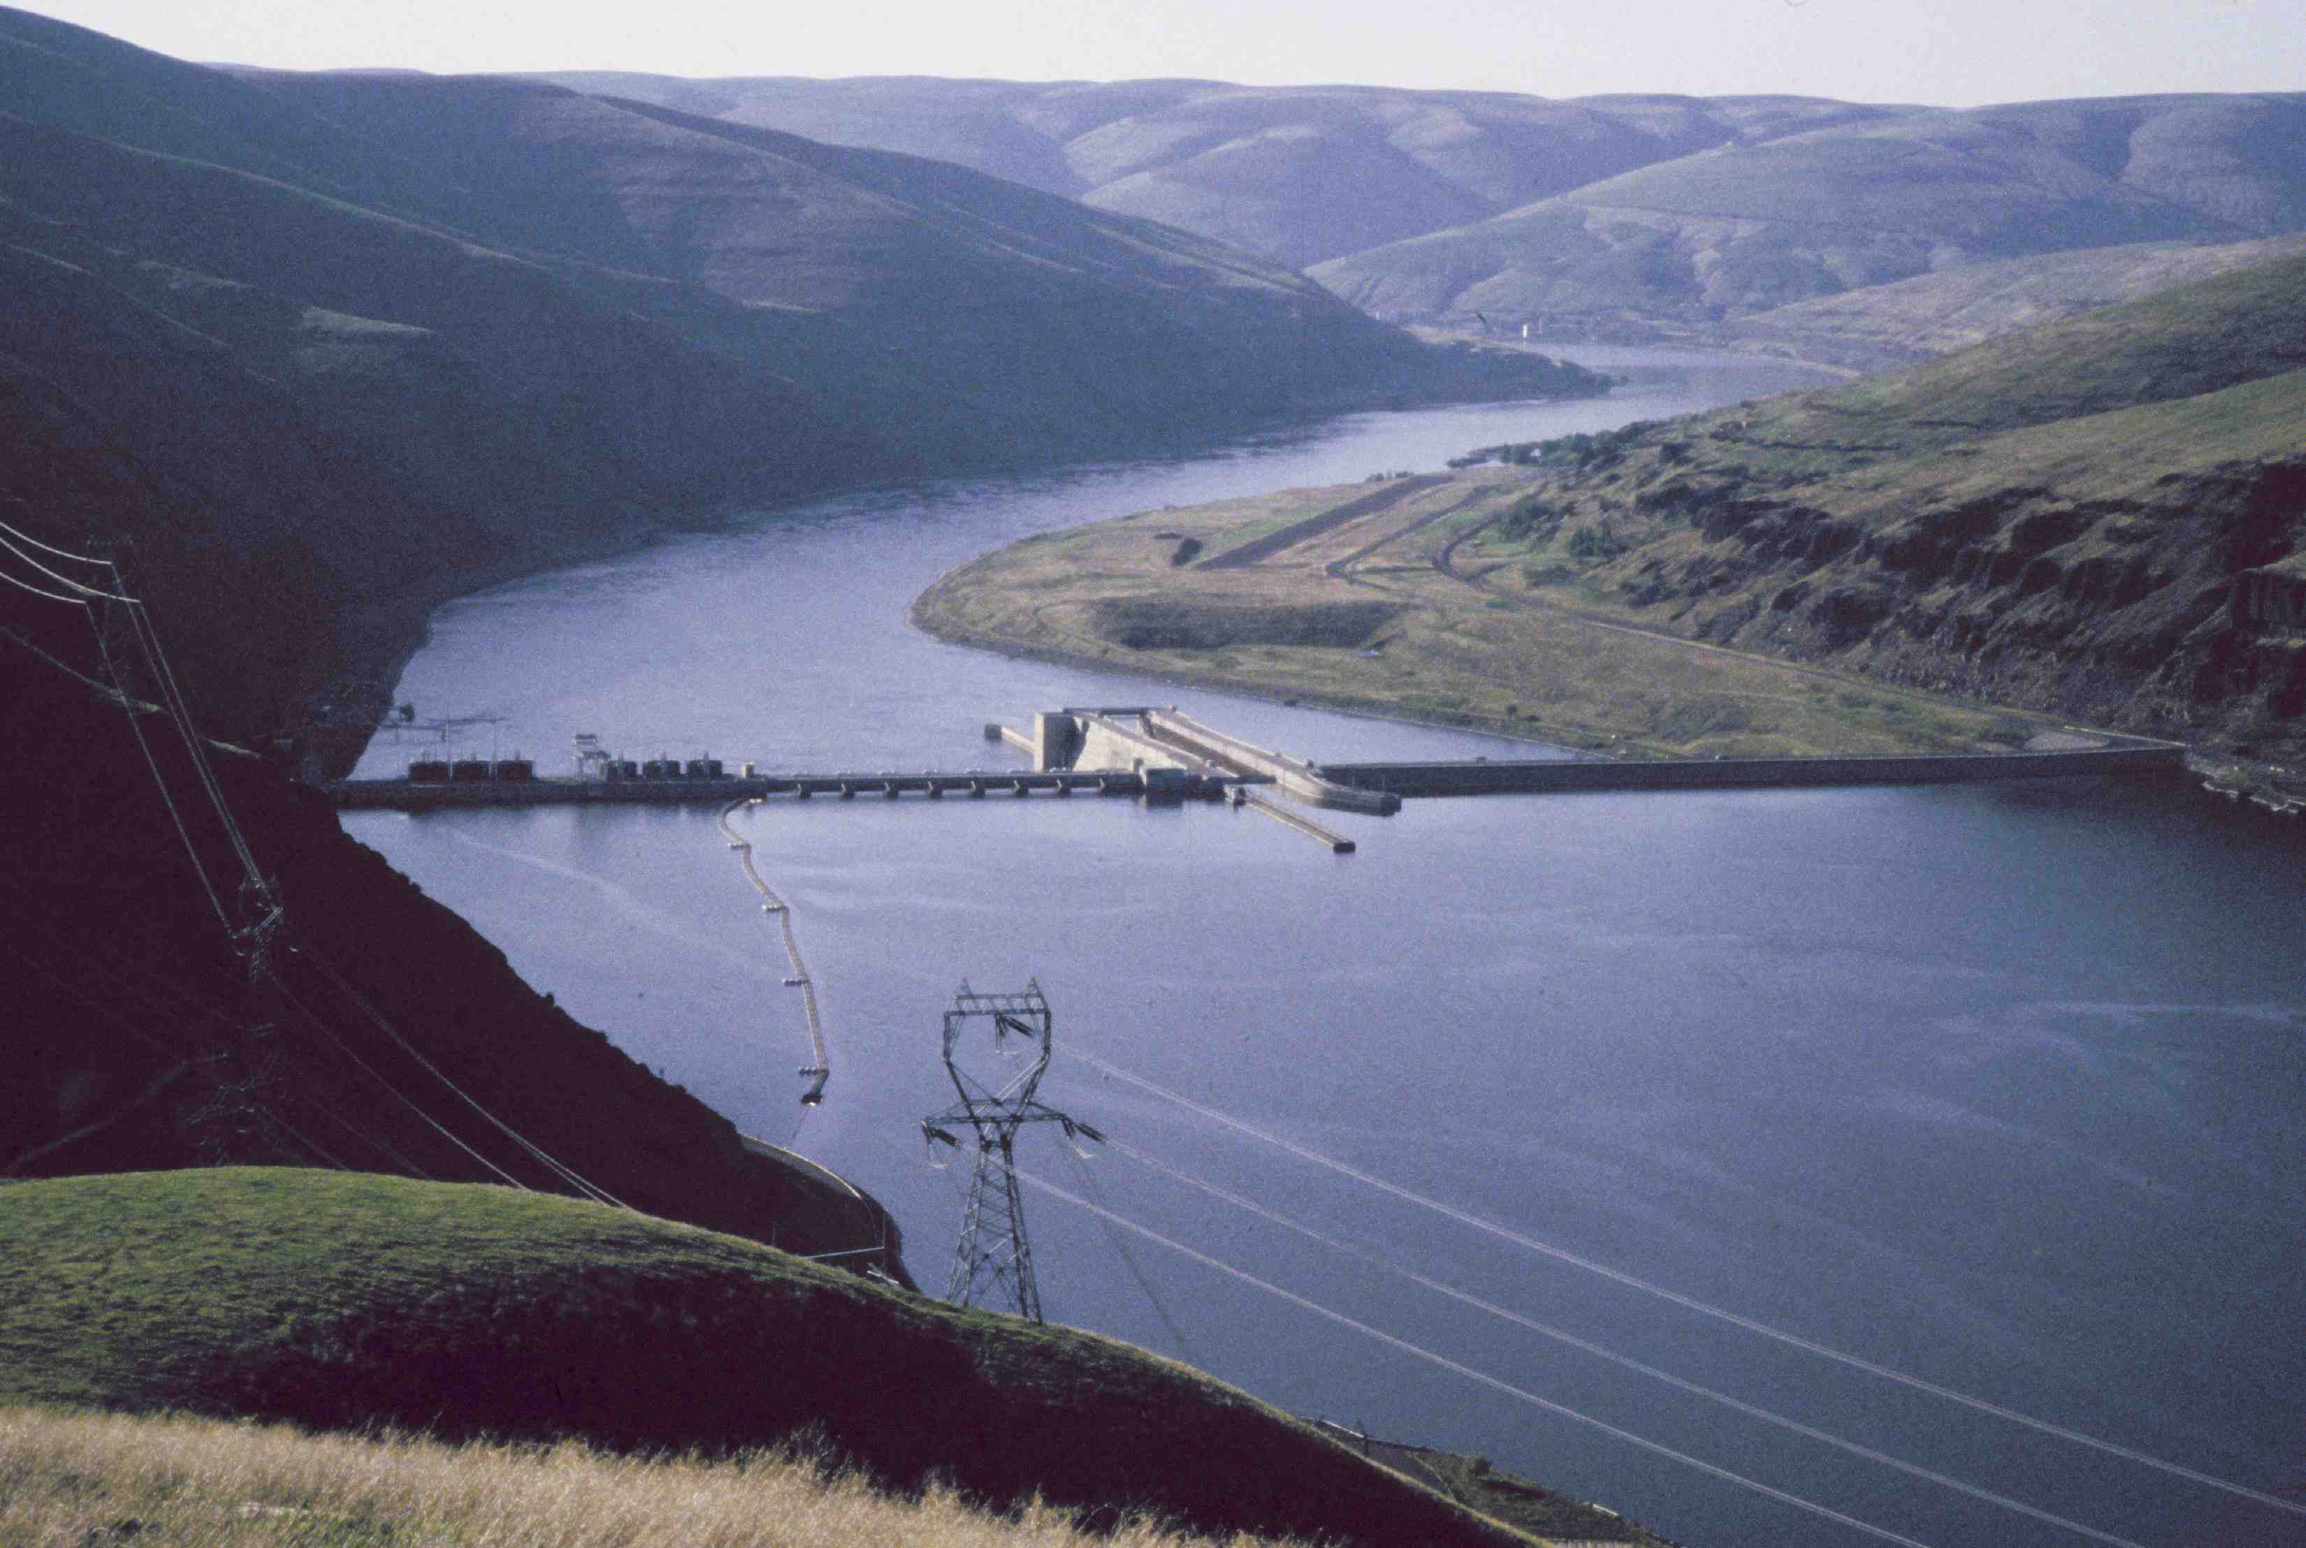
Questions

